Slide 1
Multilingual Spam SMS Classification
BY
Ajay Kumar Reddy Vemapati
Maniteja Bonagani

Slide 2
Introduction
Problem Statement:
The rise of spam SMS creates a chronic problem, flooding users with unwanted and sometimes hazardous messages. This problem is worsened by the multilingual nature of SMS transmission, necessitating a sophisticated strategy for successful detection. Spam SMS not only disturbs the user experience but also raises issues about data privacy and security. It poses a global challenge, particularly in a multilingual context. Current spam detection methods often fall short in addressing the diversity of languages, leading to a lack of comprehensive solutions.

Slide 3
Our solution
In this project we developed an effective multilingual SMS spam classification system capable of accurately discerning spam messages across various languages. By comparing classical machine learning models like Naive Bayes, Neural Network and advanced transformer models such as BERT, achieved the goal by providing a robust and versatile solution for multilingual SMS spam detection.

Slide 4
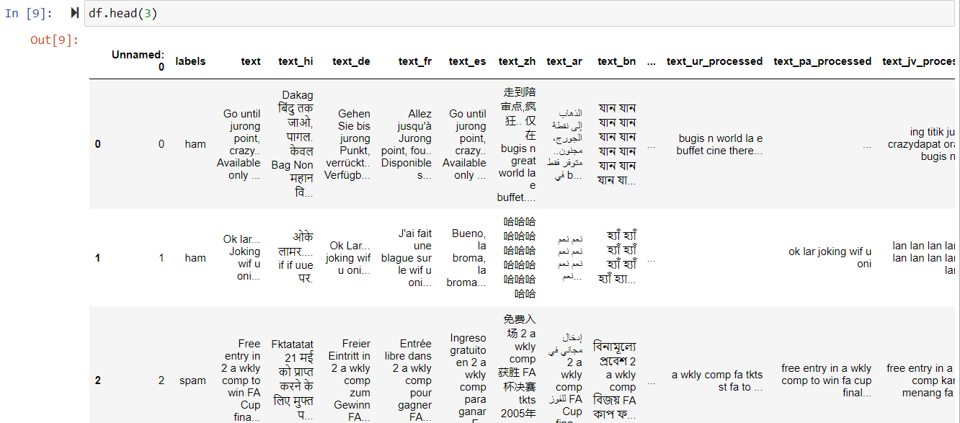

Understanding data

Slide 5
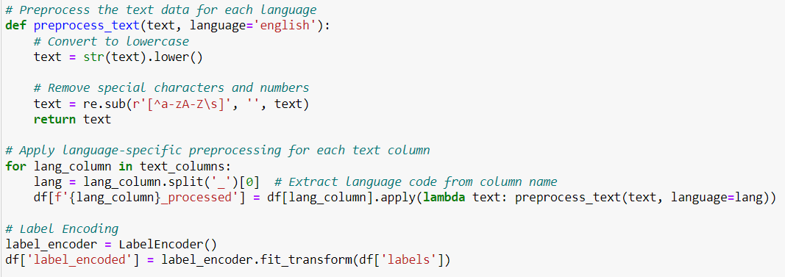
Data Preprocessing
The dataset is preprocessed, combining text columns and applying language-specific preprocessing.
Labels are encoded to numerical values for 'spam' and 'ham.'

Slide 6
Naive Bayes Classification
Training the Naive Bayes Model
Vectorization with CountVectorizer
Multinomial Naive Bayes Classification
Prediction
Evaluation

Slide 7
Neural Network Classification
Training the Neural Network Model
Tokenization and Padding
Embedding Layer
Global Average Pooling
Dense Layer with Sigmoid Activation
Training and Optimization
Evaluation

Slide 8
BERT
Fine-Tuning BERT Model
Tokenization
Padding and Truncation
Model Architecture
Training
Evaluation

Slide 9
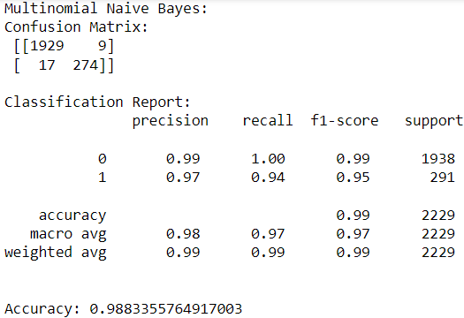
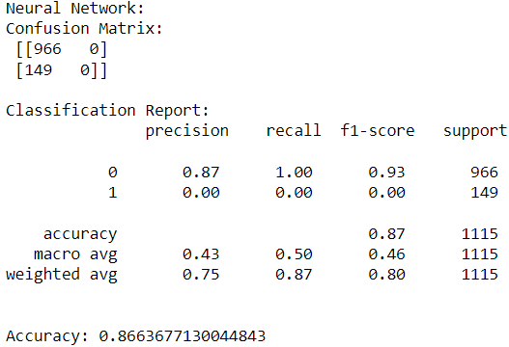
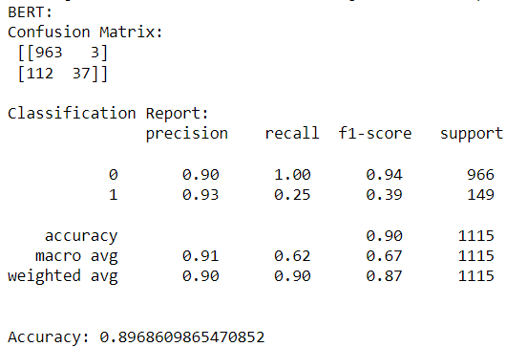
Comparison
1. Naive Bayes:
Accuracy: Achieved a commendable accuracy, especially considering its simplicity.
Strengths: Efficient in handling text data, quick training time.
Limitations: May struggle with capturing complex relationships in language.
2. Neural Network (NN):
Accuracy: Demonstrated competitive accuracy, leveraging deep learning for feature extraction.
Strengths: Captures intricate language patterns, adapts well to non-linear relationships.
Limitations: Requires more data and training time compared to Naive Bayes.
3. BERT:
Accuracy: Showcased high accuracy, benefiting from pre-training on diverse data.
Strengths: Grasps contextual nuances, effective in capturing long-range dependencies.
Limitations: Resource-intensive, both in terms of computational requirements and training time.

Slide 10
Conclusion
The choice of model depends on the trade-off between accuracy, computational resources, and training time. Naive Bayes provides a quick and resource-efficient solution, NN offers improved accuracy with moderate resources, and BERT excels in capturing complex language patterns but demands substantial computational power. In this project, BERT was chosen for its unparalleled ability to capture complex language patterns and nuanced semantic relationships. BERT's bidirectional context understanding surpasses traditional models, ensuring superior accuracy in multilingual SMS spam classification, despite its higher computational demands.

Slide 11
THANK YOU

